Slide 1
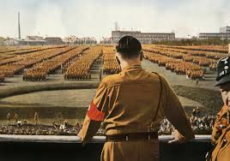
Setting the Stage for WWII

Slide 2
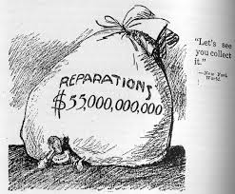
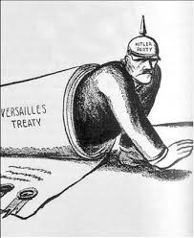
The Treaty of Versailles
Following WWI Germany was punished and humiliated by the Treaty of Versailles.
Part of the Treaty forced Germany to pay for damages. What was this called?
War Reparations!

Slide 3
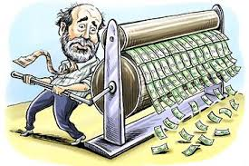
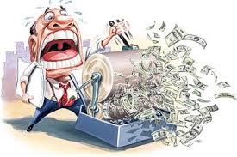
Payback Time
Germany could not afford to pay the reparations, so what did they do?
They started printing money………and didn’t stop.

Slide 4
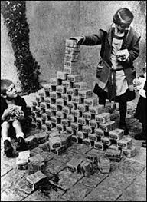
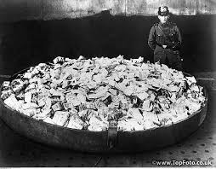
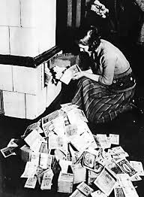
Inflation
Inflation- an economic condition when money loses its value as prices rise.
Since Germany continued printing money they suffered from inflation.
Imagine buying a candy bar for $1. The next day you go to buy another and the price is $4. This is what occurred in Germany during the 1920’s.
Because prices kept rising people couldn’t afford to eat.

Slide 5
Looking for Hope
A huge national debt, inflation, and unemployment left the German people desperate for a change.
Scared and desperate, the German people were willing to following almost anyone that promised to end their suffering………………….

Slide 7
The Rise of Dictators
In the 1920’s, Adolf Hitler stated in his book Mein Kampf (My Struggle):
“He who wants to live must fight, and he who does not want to fight in this world, where eternal struggle is the law of life, has no right to exist.”
Hitler was among other ruthless leaders to rise to power in the 1920’s and 1930’s by taking advantage of people’s anger and suffering.
Hitler and other leaders promised a better life and a glorious future.
Once they won power, these men became dictators- leaders who control their nations by force.
Civil liberties and the free press ceased to exist.
These leaders often tried to expand their countries boundaries to inherit more land, resources and control.

Slide 8
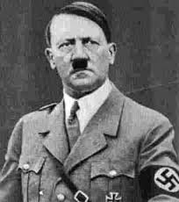
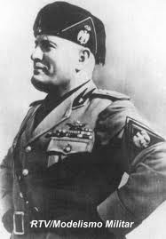
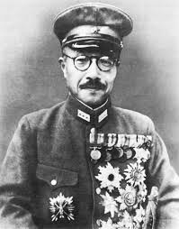
Rise of Fascism
Fascism- a political philosophy in which total power is given to a dictator and individual freedoms are denied and nationalism and, often racism are emphasized.
Fascist dictators included:
Adolf Hitler - Germany Benito Mussolini - Italy
Hideki Tojo - Japan

Slide 9
Appeasement
In 1938 Hitler and Germany annexed Austria, Sudentenland, and Czechoslovakia.
Although Hitler’s actions were a direct violation of the Treaty of Versailles, Great Britain and France only warned Hitler to stop what he was doing.
The major countries in Europe were scared to confront Hitler because it may cause another war. This was a policy of appeasement.
Germany even continued to built up their military (another violation of the Treaty of Versailles) but European countries did nothing.

Slide 10
World War II Begins
On September 1, 1939 Germany invaded Poland.
Great Britain and France had a pact with Poland, so both countries declared war on Germany.
World War II begins!

Slide 11
The Invasion of Poland
Hitler wanted more Lebensraum, or “living space,” for the German people.
On August 31st, Hitler assigned German soldiers to dress in Polish military uniforms and stage a phony (fake) invasion of Germany. The German soldiers in Polish uniforms caused little damage to nonessential positions in Germany.
Nazi propagandists publicized the “attack” by Poland as an unforgivable act of aggression.
Germany invaded Poland at 4:45 a.m. on September 1st, 1939.

Slide 12
Invasion of Poland
Germany attacked Poland using a military strategy known as blitzkrieg, or “lightning war.”
This strategy used the Luftwaffe- German air force – to bomb important sites, followed by quick movement of tanks and soldiers to overwhelm the enemy.
The Polish military was outmatched by the more modern German army.
On September 17th the Soviet Union attacked Poland from the east.
The Polish army was overwhelmed and had to surrender. Germany immediately began begins killing Jews throughout Poland.

Slide 13
The Invasion of Poland

Slide 14
The Invasion of Poland

Slide 15
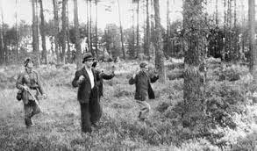
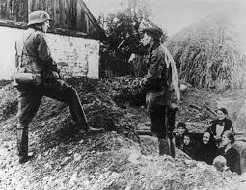
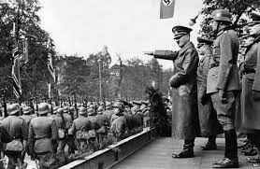
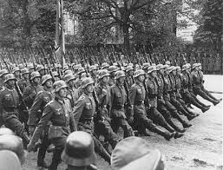
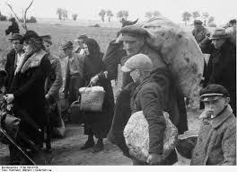
The Invasion of Poland

Slide 16
The Invasion of France
On May 10th 1940, Germany used its blitzkrieg tactics to invade France.
Germany attacked through dense forests that were not heavily protected.
The French did not believe the Germans could advance through such challenging areas, so they placed troops and installations in other areas.
Many French troops and citizens fled the country before Germans took over.
On June 25, only seven weeks after the invasion began, France surrendered to the German army.

Slide 17
The Invasion of France

Slide 18
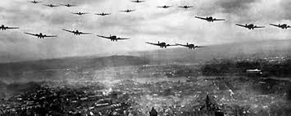
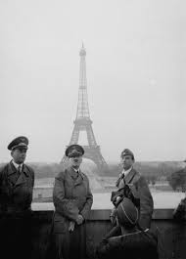
The Invasion of France

Slide 19
Now that France has surrendered, who was left to stop Hitler?

Slide 20
The Battle of Britain
From July to October 1940, Germany fought Great Britain in the first major military combat to be fought entirely in the air.
Why was the fighting only fought in the air?
The Battle was fought between the RAF –Britain's Royal Air Force – and Germany’s Luftwaffe.
Germany bombed airfields, shipping yards and later major cities in hopes of forcing Britain to surrender.
Britain was able to with stand the attacks and Hitler realized he must abandon the attacks because of his heavy losses.
The RAF and the persistence of the British citizens gave the German war machine it’s first defeat.

Slide 21
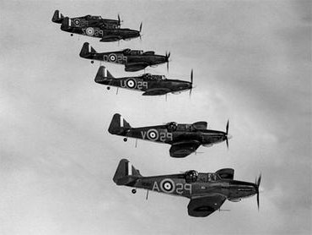
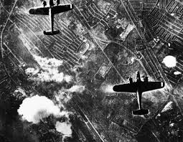
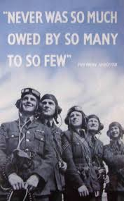
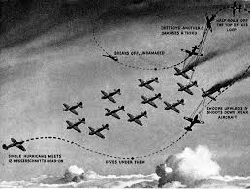
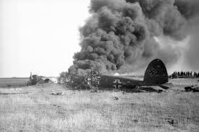
The Battle of Britain

Slide 22
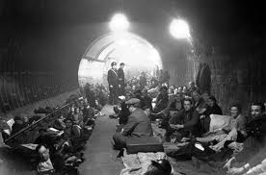
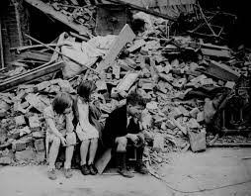
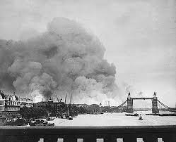
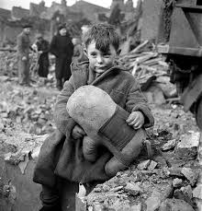
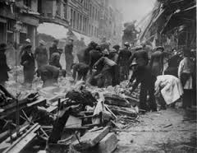
The Battle of Britain

